Slide 1
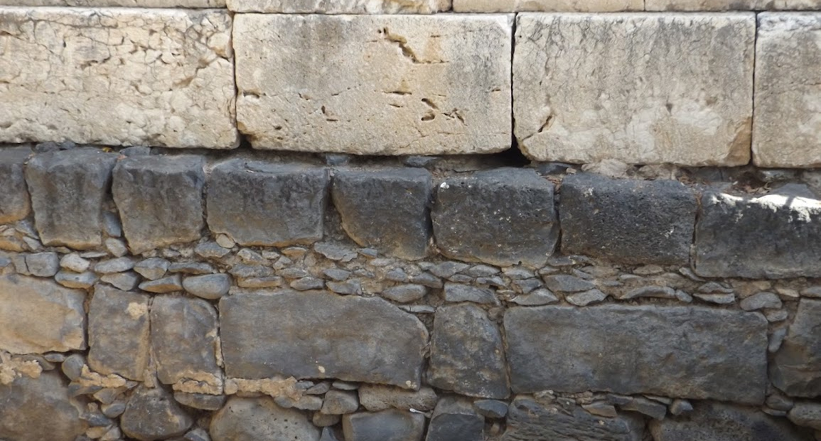

Studies in the Epistles
Foundations  Quarter 17
Lesson 5: Second Timothy 3 & 4

Slide 2
Outline of 2 Timothy Further Instructions to Paul's Beloved Son
Encouraging a Beloved Son (Chapter 1)
Thanksgiving for Timothy's upbringing, faith, and ability (1:1-7).
Invitation to share with Paul in suffering for the gospel (1:8-14).
Paul's appreciation for those who support him in the gospel (1:15-18).
Challenging a Son to Be Strong (Chapter 2)
Timothy must endure like a soldier, an athlete, and a farmer (2:1-13).
Timothy must be diligent to be a vessel useful to the Master (2:14-26).
III. Warning a Son of Perilous Times and Evil Men (Chapter 3:1--4:5)
Perilous days and evil men lie ahead (3:1-9).
In the face of peril and persecution, rely on God's Word (3:10-17).
Preach God's Word with urgency and vigilance (4:1-5).
IV. Farewell to a Son in the Hope of Meeting Again (Chapter 4:6-22)
Paul's race has been run; the crown awaits (4:6-8).
Deserted by men but not the Lord, Paul instructs Timothy to come to him (4:9-22).

Slide 3
Warning a Son of Perilous Times and Evil Men (2 Timothy 3:1--4:5)
Perilous days and evil men lie ahead (3:1-9).
Perilous times would come in the “last days” (Heb. 1:2; Acts 2:16-27).
Evil characteristics of men would make the days perilous (3:2-5).
These evil characteristics fall into four categories: Misdirected affections, lack of respect for others or holy things, lack of honesty or integrity, and ego problems.
They have a form of godliness but deny its power (Col. 2:20-23).
How Timothy is to deal with such people (3:5b-9).
He must turn away from such men (2:16-18; 1 Tim. 1:20; 6:3-5).
They will “creep” into households and make “captives of gullible women” who are “ever learning but never able” to learn the truth.
Jannes and Jambres* exemplify such teachers, resisting truth spoken by Moses.
Notes:
Hebrews 1:2 has in these last days spoken to us by His Son, whom He has appointed heir of all things, through whom also He made the worlds;
Acts 2:16-17 But this is what was spoken by the prophet Joel: 17 'AND IT SHALL COME TO PASS IN THE LAST DAYS, SAYS GOD, THAT I WILL POUR OUT OF MY SPIRIT ON ALL FLESH; YOUR SONS AND YOUR DAUGHTERS SHALL PROPHESY, YOUR YOUNG MEN SHALL SEE VISIONS, YOUR OLD MEN SHALL DREAM DREAMS.
Colossians 2:20-23 Therefore, if you died with Christ from the basic principles of the world, why, as though living in the world, do you subject yourselves to regulations— 21 "Do not touch, do not taste, do not handle," 22 which all concern things which perish with the using—according to the commandments and doctrines of men? 23 These things indeed have an appearance of wisdom in self-imposed religion, false humility, and neglect of the body, but are of no value against the indulgence of the flesh.
1 Timothy 6:3-5 If anyone teaches otherwise and does not consent to wholesome words, even the words of our Lord Jesus Christ, and to the doctrine which accords with godliness, 4 he is proud, knowing nothing, but is obsessed with disputes and arguments over words, from which come envy, strife, reviling, evil suspicions, 5 useless wranglings of men of corrupt minds and destitute of the truth, who suppose that godliness is a means of gain. From such withdraw yourself.
These are Egyptian names; Jewish written and oral tradition identifies these individuals as the lead magicians/wise men/sorcerers who resisted Moses in Exodus 7:11ff.

Slide 4
Warning a Son of Perilous Times and Evil Men (2 Timothy 3:1--4:5)
In the face of peril and persecution, rely on God's Word (3:10-17).
Timothy had watched how Paul lived when persecuted (3:10-13).
He had noted Paul’s doctrine, manner of life, purpose, faith, longsuffering, love, and perseverance,
He had seen that these things were unchanged in Paul even when persecuted in Antioch, Iconium, and Lystra (Acts 13:45; 14:5; 14:19).
The godly will be persecuted; evil men and “imposters” will grow worse.
Timothy must continue in the Scriptures.
He learned them as a child and must continue in them now; they will make him “wise for salvation” (Pr. 4:11-13; Isa. 30:21).
All Scripture is inspired of God (God breathed it), and it is profitable…
For doctrine, for reproof, for correction, for instruction in righteousness,
It thoroughly equips the man of God for every good work.
Notes:
Antioch: Acts 13:45 But when the Jews saw the multitudes, they were filled with envy; and contradicting and blaspheming, they opposed the things spoken by Paul.
Iconium: Acts 14:5 And when a violent attempt was made by both the Gentiles and Jews, with their rulers, to abuse and stone them.
Lystra Acts 14:19 Then Jews from Antioch and Iconium came there; and having persuaded the multitudes, they stoned Paul and dragged him out of the city, supposing him to be dead.
It is critical that young people realize the need to cling to the truth they’ve been taught as a guide to life in adulthood.
Proverbs 4:11-13 I have taught you in the way of wisdom; I have led you in right paths. 12 When you walk, your steps will not be hindered, And when you run, you will not stumble. 13 Take firm hold of instruction, do not let go; Keep her, for she is your life.
Isaiah 30:21 Your ears shall hear a word behind you, saying, "This is the way, walk in it," Whenever you turn to the right hand Or whenever you turn to the left.

Slide 5
Warning a Son of Perilous Times and Evil Men (2 Timothy 3:1--4:5)
Preach God's Word with urgency and vigilance (4:1-5).
Timothy is charged to preach the word!
Be ready in season and out of season.
Convince, rebuke, exhort, with all longsuffering and teaching.
The time would come when men would not “endure sound doctrine.”
They would seek teachers and preachers who tell them what they want to hear.
“They will turn their ears away from the truth” and turn “fables.”
Timothy must therefore…
Be watchful in all things.
Endure afflictions.
Do the work of an evangelist.
Fulfill your ministry.

Slide 6
Farewell to a Son in the Hope of Meeting Again (2 Timothy 4:6-22)
Paul's race has been run; the crown awaits (4:6-8).
Paul is being poured out as a drink offering (Num. 28:7; Phil. 2:17).
He has fought the good fight, finished the race, and kept the faith.
He anticipates receiving a “crown of life” from the Righteous Judge.
Others who “love His appearing” should anticipate the same (1 Peter 5:4; Rev. 2:10; James 1:12).
Paul instructs Timothy to come to him (4:9-22).
Several of Paul’s coworkers were not with him (4:10-12, 20)
Some were involved in work elsewhere, but Demas forsook Paul, having loved this present world (cf. Phile. 24; 1 John 2:15-17).
So, it is urgent that Timothy come and bring Mark with him, as well as a cloak and certain books and parchments (4:9, 13, 21).
Timothy must “come before winter.”
Notes:
Numbers 28:7 And its drink offering shall be one-fourth of a hin for each lamb; in a holy place you shall pour out the drink to the LORD as an offering.
Philippians 2:17 Yes, and if I am being poured out as a drink offering on the sacrifice and service of your faith, I am glad and rejoice with you all.
1 Peter 5:4 and when the Chief Shepherd appears, you will receive the crown of glory that does not fade away
Revelation 2:10 Be faithful until death, and I will give you the crown of life.
James 1:12 Blessed is the man who endures temptation; for when he has been approved, he will receive the crown of life which the Lord has promised to those who love Him.
Philemon 1:23-24 Epaphras, my fellow prisoner in Christ Jesus, greets you, 24 as do Mark, Aristarchus, Demas, Luke, my fellow laborers.

Slide 7
Farewell to a Son in the Hope of Meeting Again (2 Timothy 4:6-22)
Paul had been deserted by men but not the Lord (4:14-18)
Alexander the coppersmith had done Paul a lot of harm; Timothy must beware of him because he “resisted our words.”
No one stood with Paul at his first defense.
Yet he prays that it not be charged against them (Acts 7:60; Lk. 23:34).
Note the difference in what Paul desires for these individuals and what he wanted to happen to Alexander.
But the Lord had stood with Paul, and he trusts the Lord for his ultimate deliverance – “the Lord will deliver me from every evil work and preserve me for His heavenly kingdom.”
Notes:
Acts 7:60 Then he knelt down and cried out with a loud voice, "Lord, do not charge them with this sin." And when he had said this, he fell asleep.
Luke 23:34 Then Jesus said, "Father, forgive them, for they do not know what they do." And they divided His garments and cast lots.

Slide 8
Important Lessons:
Evil people create perilous times for those who believe the truth.
We must turn away from those who have a form of godliness but deny its power.
Come what may in terms of persecution or evil times, we must live godly lives, heeding and adhering to the Scriptures.
We must share God’s word with urgency at all times; the time will come when people don’t want to hear it.
Let us pour ourselves out as a drink offering for the Lord – use ourselves up in His service, for His glory.
Let us fight the good fight, finish our race, and keep the faith in order to receive a crown of righteousness.

